Slide 1
CAP 4770:
Introduction to Data Mining
Fall 2008
Dr. Tao Li
Florida International University

Slide 2
Outline
Course Logistics
Data Mining Introduction
Four Key Characteristics
  Combination of Theory and Application
  Engineering Process
  Collection of Functionalities
  Interdisciplinary field
How do we categorize data mining systems?
History of Data Mining
Research Issues

Slide 3

Data Mining: An Engineering Process
  Data mining: interactive and iterative process.
Interpretation/
Evaluation
Mining Algorithms
Knowledge
Preprocessing
Patterns
Selection
Preprocessed
Data
Data
Target
Data
adapted from:
U. Fayyad, et al. (1995), “From Knowledge Discovery to Data Mining: An Overview,” Advances in Knowledge Discovery and Data Mining, U. Fayyad et al. (Eds.), AAAI/MIT Press
Notes:
Mine for:
Selection
Aggregation
Abstraction
Visualization
Transformation/Conversion
Statistical Analysis
“Cleaning”

Slide 4
Steps of a KDD Process
Learning the application domain
  relevant prior knowledge and goals of application
Creating a target data set: data selection
Data cleaning and preprocessing: (may take 60% of effort!)
Data reduction and transformation
  Find useful features, dimensionality/variable reduction, invariant representation.
Choosing functions of data mining
  summarization, classification, regression, association, clustering.
Choosing the mining algorithm(s)
Data mining: search for patterns of interest
Pattern evaluation and knowledge presentation
  visualization, transformation, removing redundant patterns, etc.
Use of discovered knowledge

Slide 5
Outline
Course Logistics
Data Mining Introduction
Four Key Characteristics
  Combination of Theory and Application
  Engineering Process
  Collection of Functionalities
  Interdisciplinary field
How do we categorize data mining systems?
History of Data Mining
Research Issues
  Curse of Dimensionality

Slide 6
Architecture of a Typical Data Mining System
Graphical user interface
Pattern evaluation
Data mining engine
Knowledge-base
Database or data warehouse server
Data cleaning & data integration
Filtering
Data
Warehouse
Databases

Slide 7
Data Mining: On What Kind of Data?
Relational databases
Data warehouses
Transactional databases
Advanced DB and information repositories
  Object-oriented and object-relational databases
  Spatial databases
  Time-series data and temporal data
  Text databases and multimedia databases
  Heterogeneous and legacy databases
  WWW

Slide 8
What Can Data Mining Do?
Cluster
Classify
  Categorical, Regression
Semi-supervised
Summarize
  Summary statistics, Summary rules
Link Analysis / Model Dependencies
  Association rules
Sequence analysis
  Time-series analysis, Sequential associations
Detect Deviations

Slide 9
Data Mining Tasks
Prediction Methods
  Use some variables to predict unknown or future values of other variables.
Description Methods
  Find human-interpretable patterns that describe the data.
From [Fayyad, et.al.] Advances in Knowledge Discovery and Data Mining, 1996

Slide 10
Data Mining Tasks...
Classification [Predictive]
Clustering [Descriptive]
Association Rule Discovery [Descriptive]
Sequential Pattern Discovery [Descriptive]
Regression [Predictive]
Deviation Detection [Predictive]

Slide 11


Classification Example
categorical
categorical
continuous
class
Test
Set
Learn
Classifier
Training
Set
Model

Slide 12
Classification: Definition
Given a collection of records (training set )
  Each record contains a set of attributes, one of the attributes is the class.
Find a model for class attribute as a function of the values of other attributes.
Goal: previously unseen records should be assigned a class as accurately as possible.
  A test set is used to determine the accuracy of the model. Usually, the given data set is divided into training and test sets, with training set used to build the model and test set used to validate it.

Slide 13
Classification: Application 1
Direct Marketing
  Goal: Reduce cost of mailing by targeting a set of consumers likely to buy a new cell-phone product.
  Approach:
    Use the data for a similar product introduced before.
    We know which customers decided to buy and which decided otherwise. This {buy, don’t buy} decision forms the class attribute.
    Collect various demographic, lifestyle, and company-interaction related information about all such customers.
      Type of business, where they stay, how much they earn, etc.
    Use this information as input attributes to learn a classifier model.
From [Berry & Linoff] Data Mining Techniques, 1997

Slide 14
Classification: Application 2
Fraud Detection
  Goal: Predict fraudulent cases in credit card transactions.
  Approach:
    Use credit card transactions and the information on its account-holder as attributes.
      When does a customer buy, what does he buy, how often he pays on time, etc
    Label past transactions as fraud or fair transactions. This forms the class attribute.
    Learn a model for the class of the transactions.
    Use this model to detect fraud by observing credit card transactions on an account.

Slide 15
Classification: Application 3
Customer Attrition/Churn:
  Goal: To predict whether a customer is likely to be lost to a competitor.
  Approach:
    Use detailed record of transactions with each of the past and present customers, to find attributes.
      How often the customer calls, where he calls, what time-of-the day he calls most, his financial status, marital status, etc.
    Label the customers as loyal or disloyal.
    Find a model for loyalty.
From [Berry & Linoff] Data Mining Techniques, 1997

Slide 16
Classification: Application 4
Sky Survey Cataloging
  Goal: To predict class (star or galaxy) of sky objects, especially visually faint ones, based on the telescopic survey images (from Palomar Observatory).
      3000 images with 23,040 x 23,040 pixels per image.
  Approach:
    Segment the image.
    Measure image attributes (features) - 40 of them per object.
    Model the class based on these features.
    Success Story: Could find 16 new high red-shift quasars, some of the farthest objects that are difficult to find!
From [Fayyad, et.al.] Advances in Knowledge Discovery and Data Mining, 1996

Slide 17
Clustering Definition
Given a set of data points, each having a set of attributes, and a similarity measure among them, find clusters such that
  Data points in one cluster are more similar to one another.
  Data points in separate clusters are less similar to one another.
Similarity Measures:
  Euclidean Distance if attributes are continuous.
  Other Problem-specific Measures.

Slide 18
Illustrating Clustering
Euclidean Distance Based Clustering in 3-D space.
Intracluster distances
are minimized
Intercluster distances
are maximized

Slide 19
Clustering: Application 1
Market Segmentation:
  Goal: subdivide a market into distinct subsets of customers where any subset may conceivably be selected as a market target to be reached with a distinct marketing mix.
  Approach:
    Collect different attributes of customers based on their geographical and lifestyle related information.
    Find clusters of similar customers.
    Measure the clustering quality by observing buying patterns of customers in same cluster vs. those from different clusters.

Slide 20
Clustering: Application 2
Document Clustering:
  Goal: To find groups of documents that are similar to each other based on the important terms appearing in them.
  Approach: To identify frequently occurring terms in each document. Form a similarity measure based on the frequencies of different terms. Use it to cluster.
  Gain: Information Retrieval can utilize the clusters to relate a new document or search term to clustered documents.

Slide 21
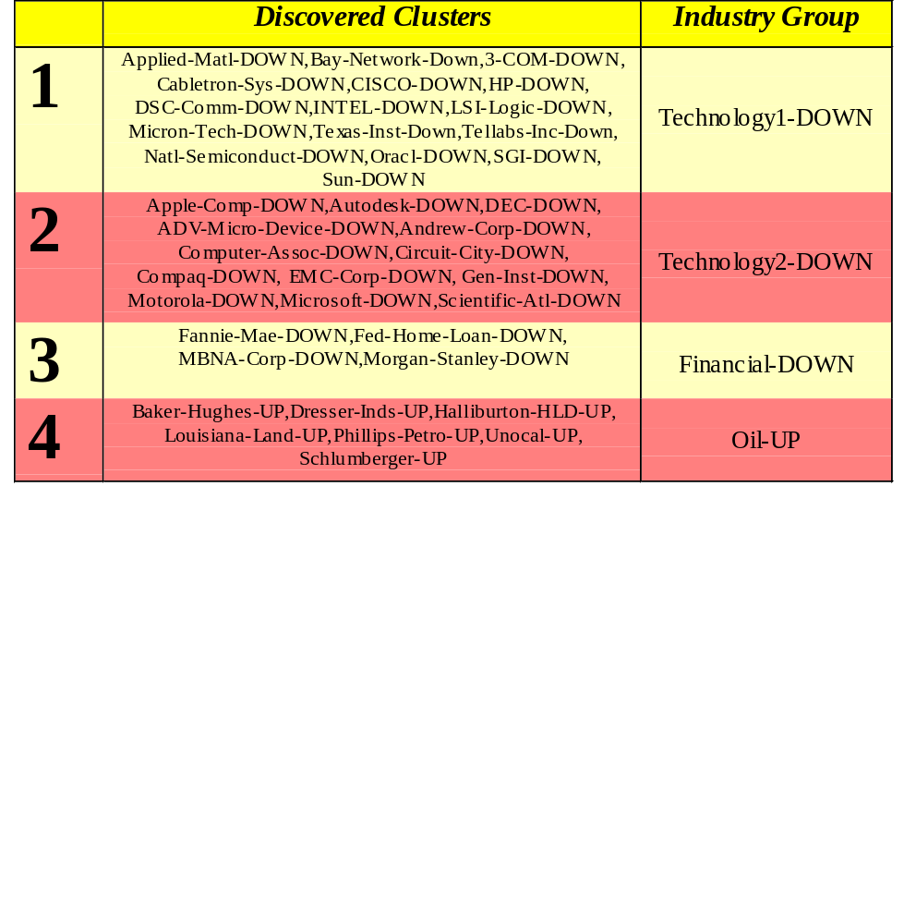
Clustering of S&P 500 Stock Data
Observe Stock Movements every day.
Clustering points: Stock-{UP/DOWN}
Similarity Measure: Two points are more similar if the events described by them frequently happen together on the same day.
  We used association rules to quantify a similarity measure.

Slide 22

Association Rule Discovery: Definition
Given a set of records each of which contain some number of items from a given collection;
  Produce dependency rules which will predict occurrence of an item based on occurrences of other items.
Rules Discovered:
{Milk} --> {Coke}
{Diaper, Milk} --> {Beer}

Slide 23
Association Rule Discovery: Application 1
Marketing and Sales Promotion:
  Let the rule discovered be
  {Bagels, … } --> {Potato Chips}
  Potato Chips as consequent => Can be used to determine what should be done to boost its sales.
  Bagels in the antecedent => Can be used to see which products would be affected if the store discontinues selling bagels.
  Bagels in antecedent and Potato chips in consequent => Can be used to see what products should be sold with Bagels to promote sale of Potato chips!

Slide 24
Association Rule Discovery: Application 2
Supermarket shelf management.
  Goal: To identify items that are bought together by sufficiently many customers.
  Approach: Process the point-of-sale data collected with barcode scanners to find dependencies among items.
  A classic rule --
    If a customer buys diaper and milk, then he is very likely to buy beer.
    So, don’t be surprised if you find six-packs stacked next to diapers!

Slide 25
Association Rule Discovery: Application 3
Inventory Management:
  Goal: A consumer appliance repair company wants to anticipate the nature of repairs on its consumer products and keep the service vehicles equipped with right parts to reduce on number of visits to consumer households.
  Approach: Process the data on tools and parts required in previous repairs at different consumer locations and discover the co-occurrence patterns.

Slide 26
Sequential Pattern Discovery: Definition
Given is a set of objects, with each object associated with its own timeline of events, find rules that predict strong sequential dependencies among different events.
Rules are formed by first disovering patterns. Event occurrences in the patterns are governed by timing constraints.
(A B) (C) (D E)
(A B) (C) (D E)
<= xg
>ng
<= ws
<= ms

Slide 27
Sequential Pattern Discovery: Examples
In telecommunications alarm logs,
  (Inverter_Problem Excessive_Line_Current)
  (Rectifier_Alarm) --> (Fire_Alarm)
In point-of-sale transaction sequences,
  Computer Bookstore:
  (Intro_To_Visual_C) (C++_Primer) --> (Perl_for_dummies,Tcl_Tk)
  Athletic Apparel Store:
  (Shoes) (Racket, Racketball) --> (Sports_Jacket)

Slide 28
Regression
Predict a value of a given continuous valued variable based on the values of other variables, assuming a linear or nonlinear model of dependency.
Greatly studied in statistics, neural network fields.
Examples:
  Predicting sales amounts of new product based on advetising expenditure.
  Predicting wind velocities as a function of temperature, humidity, air pressure, etc.
  Time series prediction of stock market indices.

Slide 29





Deviation/Anomaly Detection
Detect significant deviations from normal behavior
Applications:
  Credit Card Fraud Detection
  Network Intrusion
  Detection
Typical network traffic at University level may reach over 100 million connections per day

Slide 30
Types of Data Mining Output
Data dependency analysis - identifying potentially interesting dependencies or relationships among data items
Classification - grouping records into meaningful subclasses or clusters
Deviation detection - discovery of significant differences between an observation and some reference – potentially correct the data
  Anomalous instances, Outliers
  Classes with average values significantly different than parent or sibling class
  Changes in value from one time period to another
  Discrepancies between observed and expected values
Concept description - developing an abstract description of members of a population
  Characteristic descriptions - patterns in the data that best describe or summarize a class
  Discriminating descriptions - describe how classes differ

Slide 31
Are All the “Discovered” Patterns Interesting?
A data mining system/query may generate thousands of patterns, not all of them are interesting.
  Suggested approach: Human-centered, query-based, focused mining
Interestingness measures: A pattern is interesting if it is easily understood by humans, valid on new or test data with some degree of certainty, potentially useful, novel, or validates some hypothesis that a user seeks to confirm
  Objective vs. subjective interestingness measures:

Slide 32
Outline
Course Logistics
Data Mining Introduction
Four Key Characteristics
  Combination of Theory and Application
  Engineering Process
  Collection of Functionalities
  Interdisciplinary field
How do we categorize data mining systems?
History of Data Mining
Research Issues

Slide 33
Multiple Disciplines
Machine
Learning
Artificial
Intelligence
Database
Management
Statistics
Algorithms
Visualization
Data
Mining
Systems
Information
Retrieval
Notes:
10

Slide 34
Outline
Course Logistics
Data Mining Introduction
Four Key Characteristics
  Combination of Theory and Application
  Engineering Process
  Collection of Functionalities
  Interdisciplinary field
How do we categorize data mining systems?
History of Data Mining
Research Issues

Slide 35
Data Mining: Classification Schemes
General functionality
  Descriptive data mining
  Predictive data mining
Different views, different classifications
  Kinds of databases to be mined
  Kinds of knowledge to be discovered
  Kinds of techniques utilized
  Kinds of applications adapted

Slide 36
Multi-Dimensional View of Data Mining
Data to be mined
  Relational, data warehouse, transactional, stream, object-oriented/relational, active, spatial, time-series, text, multi-media, heterogeneous, legacy, WWW
Knowledge to be mined
  Characterization, discrimination, association, classification, clustering, trend/deviation, outlier analysis, etc.
  Multiple/integrated functions and mining at multiple levels
Techniques utilized
  Database-oriented, data warehouse (OLAP), machine learning, statistics, visualization, etc.
Applications adapted
  Retail, telecommunication, banking, fraud analysis, bio-data mining, stock market analysis, Web mining, etc.

Slide 37
Outline
Course Logistics
Data Mining Introduction
Four Key Characteristics
  Combination of Theory and Application
  Engineering Process
  Collection of Functionalities
  Interdisciplinary field
How do we categorize data mining systems?
History of Data Mining
Research Issues

Slide 38
History of the Data Mining
Knowledge Discovery in Databases workshops started ‘89
  Now a conference under the auspices of ACM SIGKDD
  IEEE conference series started 2001
Key founders / technology contributors:
  Usama Fayyad, JPL (then Microsoft, now has his own company, Digimine)
  Gregory Piatetsky-Shapiro (then GTE, now his own data mining consulting company, Knowledge Stream Partners)
  Rakesh Agrawal (IBM Research)
The term “data mining” has been around since at least 1983 – as a pejorative term in the statistics community

Slide 39
A Brief History of Data Mining Society
1989 IJCAI Workshop on Knowledge Discovery in Databases (Piatetsky-Shapiro)
  Knowledge Discovery in Databases (G. Piatetsky-Shapiro and W. Frawley, 1991)
1991-1994 Workshops on Knowledge Discovery in Databases
  Advances in Knowledge Discovery and Data Mining (U. Fayyad, G. Piatetsky-Shapiro, P. Smyth, and R. Uthurusamy, 1996)
1995-1998 International Conferences on Knowledge Discovery in Databases and Data Mining (KDD’95-98)
  Journal of Data Mining and Knowledge Discovery (1997)
1998 ACM SIGKDD, SIGKDD’1999-2001 conferences, and SIGKDD Explorations
More conferences on data mining
  SIAM-Data Mining (2001), (IEEE) ICDM (2001), etc.

Slide 40
Outline
Course Logistics
Data Mining Introduction
Four Key Characteristics
  Combination of Theory and Application
  Engineering Process
  Collection of Functionalities
  Interdisciplinary field
How do we categorize data mining systems?
History of Data Mining
Research Issues

Slide 41
Data Mining Complications
Volume of Data
  Clever algorithms needed for reasonable performance
Interest measures
  How do we ensure algorithms select “interesting” results?
“Knowledge Discovery Process” skill required
  How to select tool, prepare data?
Data Quality
  How do we interpret results in light of low quality data?
Data Source Heterogeneity
  How do we combine data from multiple sources?
Notes:
Large volume
How does the discovery algorithm focus, i.e., select which subset of the data to analyze next
Noise and uncertainty
Uncertainty regarding correctness of data
Patterns may be valid over some but not all data
Redundant information
Information reoccurs in multiple places in the database
Dynamic data
Database contents are constantly changing
Sparse data
Database data is often sparse in terms of density of actual records over the potential instance space

Slide 42
Research Issues
Mining methodology
  Mining different kinds of knowledge from diverse data types, e.g., bio, stream, Web
  Performance: efficiency, effectiveness, and scalability
  Pattern evaluation: the interestingness problem
  Incorporation of background knowledge
  Handling noise and incomplete data
  Parallel, distributed and incremental mining methods
  Integration of the discovered knowledge with existing one: knowledge fusion
User interaction
  Data mining query languages and ad-hoc mining
  Expression and visualization of data mining results
  Interactive mining of knowledge at multiple levels of abstraction
Applications and social impacts
  Domain-specific data mining & invisible data mining
  Protection of data security, integrity, and privacy

